Slide 1




Detection and identification of a path for camera calibration
B.S.C.S. Franci Suni Lopez

Slide 2
Pipeline
Binarization
Noise filter
Edge detection
Ellipse detection
Ellipses selection
Draw centers

Slide 3
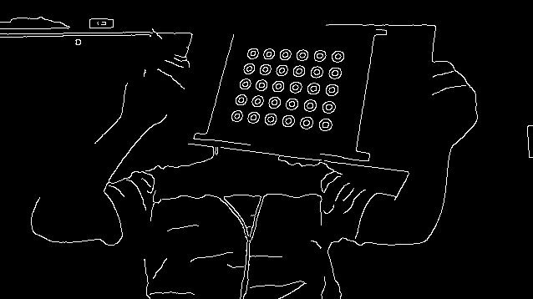
Binarization, noise filter and edge detection
Convert current frame to Gray Scale
Apply a Gaussian BLUR of size 5x5
Why 5x5?
Canny edge detection

Slide 4
Ellipse detection and selection
Delete contours points < 10
Delete contours d1 or d2 < 4
Delete
d1
d2

Slide 5
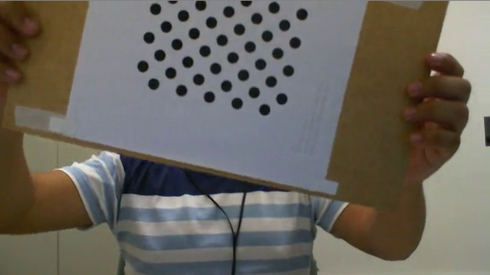
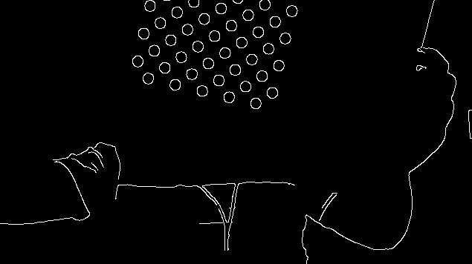
Ellipse detection and selection
Do not recognize path when number of detected ellipses is < number of path rings

Slide 6
Ellipse detection and selection
Do not recognize path when number of detected ellipses is < number of path rings

Slide 7
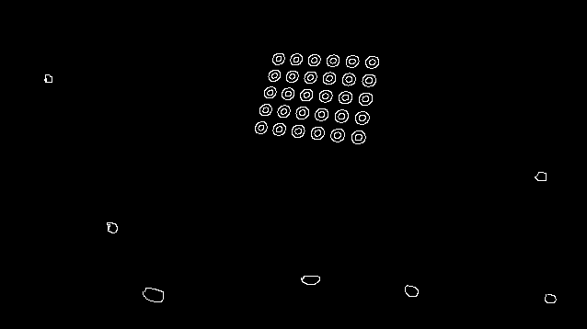
Selection of correct Ellipses
Centroid of ellipses center
Standard deviation of distances

Slide 8
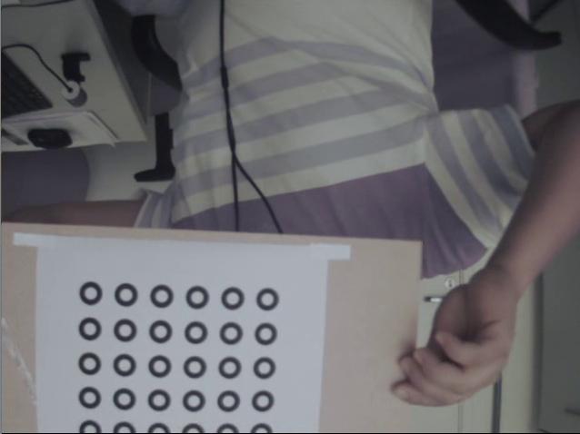
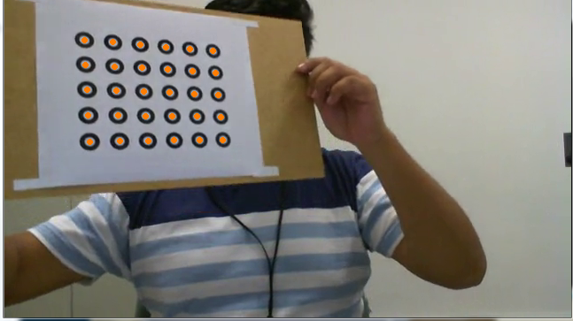
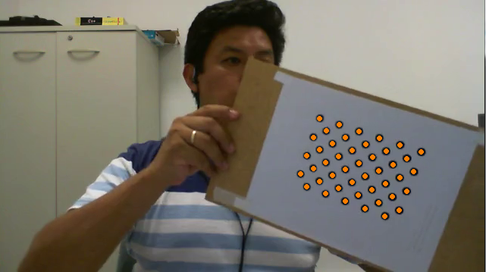
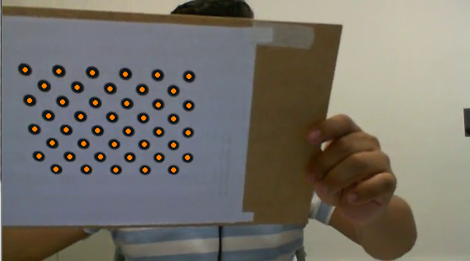
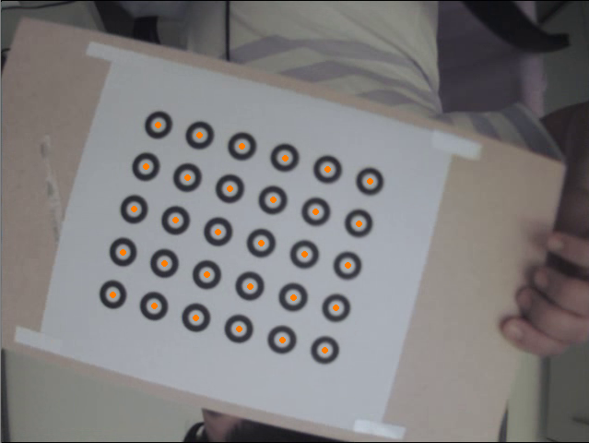
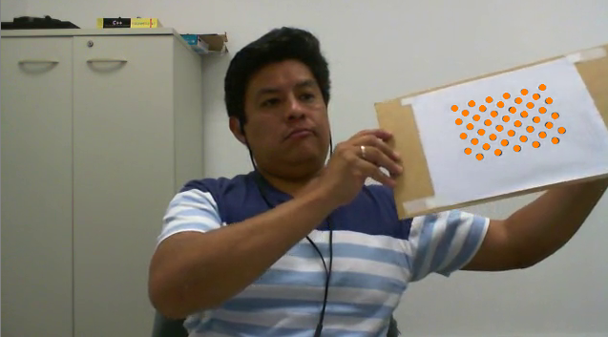
Results

Slide 9
Limitations
Changes of ilumination

Slide 10
Thanks!
Questions?
Franci Suni Lopez
franci.suni@ucsp.edu.pe

